Slide 1
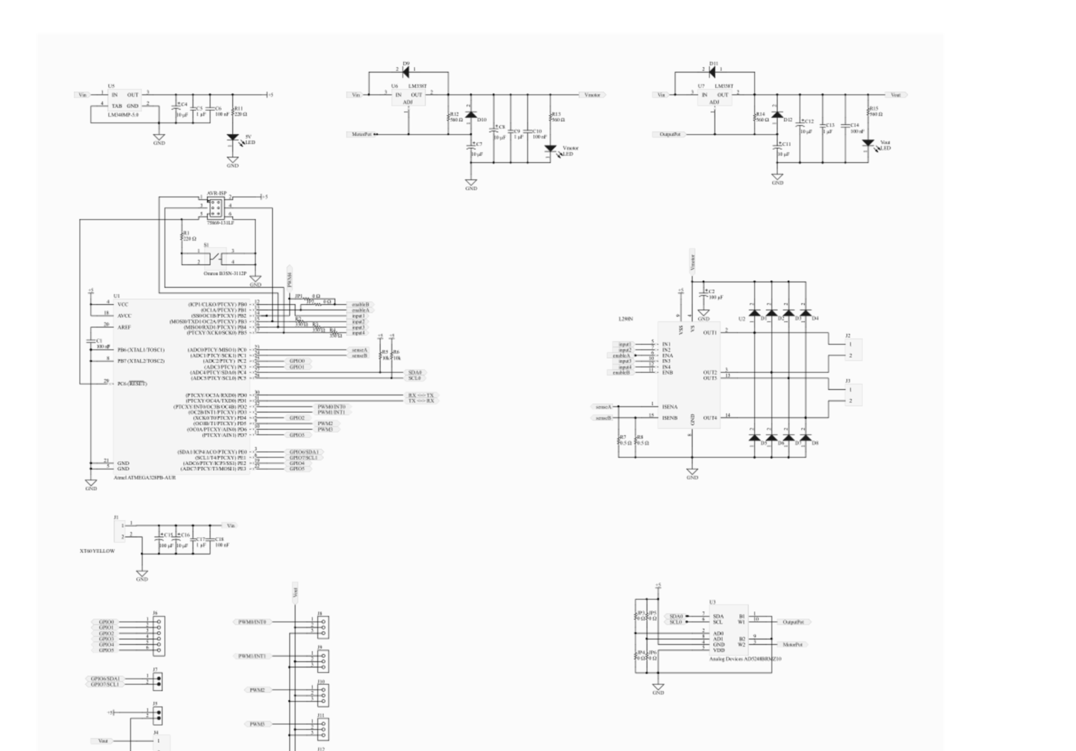

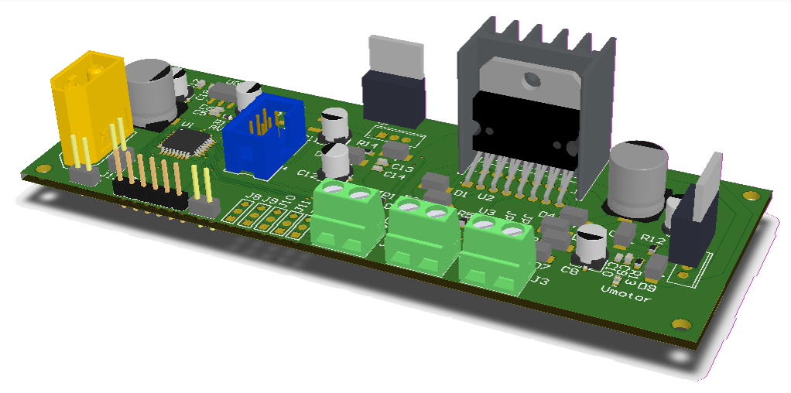
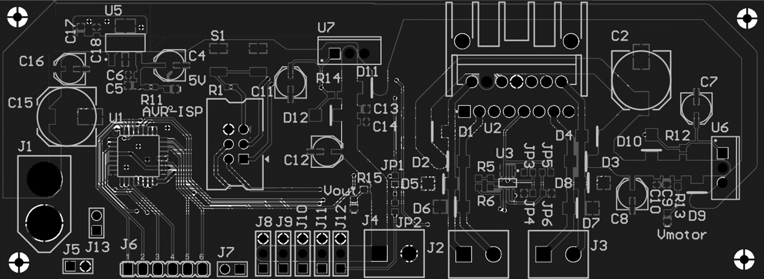
AVR-Based Robotics Controller
Justin Derickson
4:30pm - 5:30pm
December 5th
Stepper and dual DC motor control.
Dual digitally adjustable power supplies.
PC, Pixhawk, and Ardupilot compatible.
Integrate with Raspberry Pi and Arduino.

